Slide 1
Parallel Programming
汤德佑
dytang@scut.edu.cn

Slide 2
Section1-Why Parallel Computing

Slide 3
Course Goals
The students will get the skills to use some of the best existing parallel programming tools, and be exposed to a number of open research questions
This course will
provide an introduction to parallel computing including parallel computer architectures, analytical modeling of parallel programs
include materials on MPI, Pthreads, OpenMP

Slide 4
Why Parallel Computing?
APPLICATION DEMANDS

Slide 5
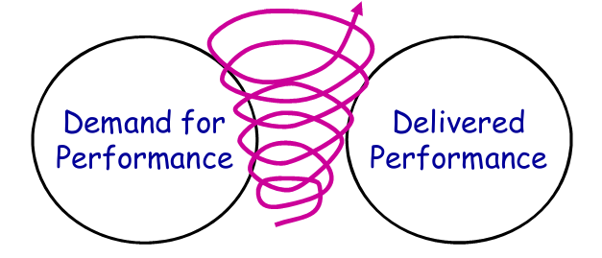
Application Trends
There is a positive feedback cycle between delivered performance and applications’ demand for performance
Example application domains:
Scientific computing : CFD, Biology, Chemistry, Physics, ...
General-purpose computing : Video, Graphics, CAD, Databases, …
How about applications’ demand for performance nowadays?

Slide 6

Climate modeling

Slide 7
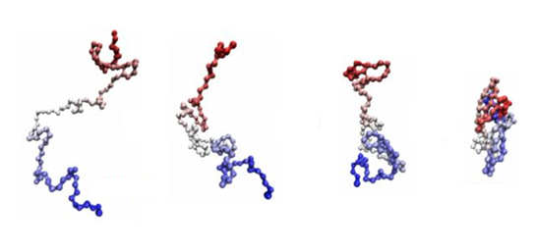
Protein folding

Slide 8


Drug discovery

Slide 9


Energy research

Slide 10


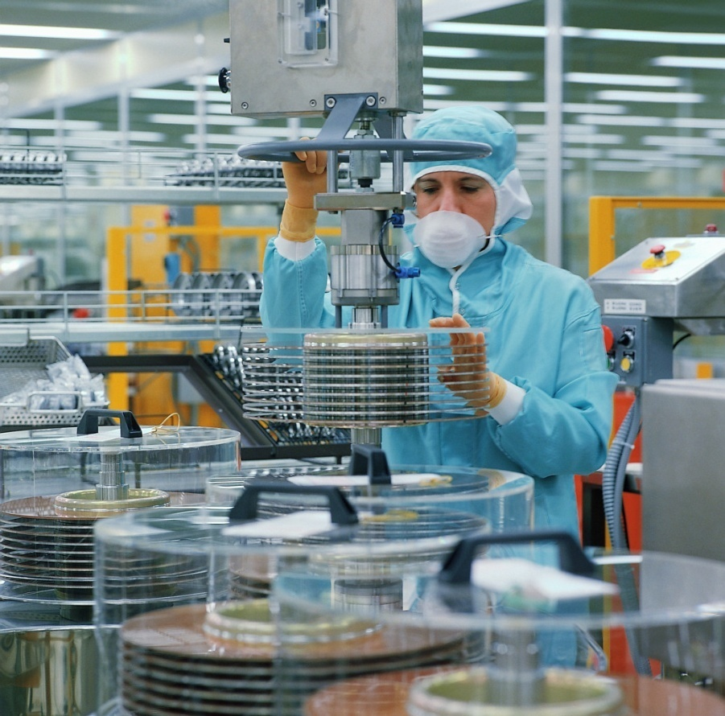
Data analysis

Slide 11
View of Hardware-Moore’s Law (1965)
Moore's law is the observation that, over the history of computing hardware, the number of transistors on integrated circuits doubles approximately every two years.
Transistors per inch square
Twice as many after ~1.5-2 years
Related trends
Processor performance:Twice as fast after ~18 months
Memory capacity:Twice as much in <2 years

Slide 12
Changing times
From 1986 – 2002, microprocessors were speeding like a rocket, increasing in performance an average of 50% per year.
Since then, it’s dropped to about 20% increase per year.

Slide 13
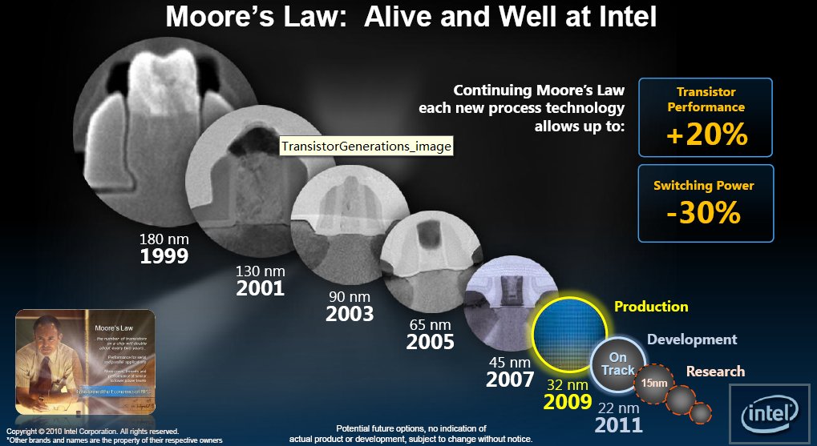

Slide 14
Moore’s Not-Exactly-Law
Not a law of nature
But fairly accurate over 42 years and counting
No exponential is forever but we can delay “forever” (Gordon Moore in 2003)
More about Moore’s Law at http://www.intel.com/research/silicon/mooreslaw.htm

Slide 15
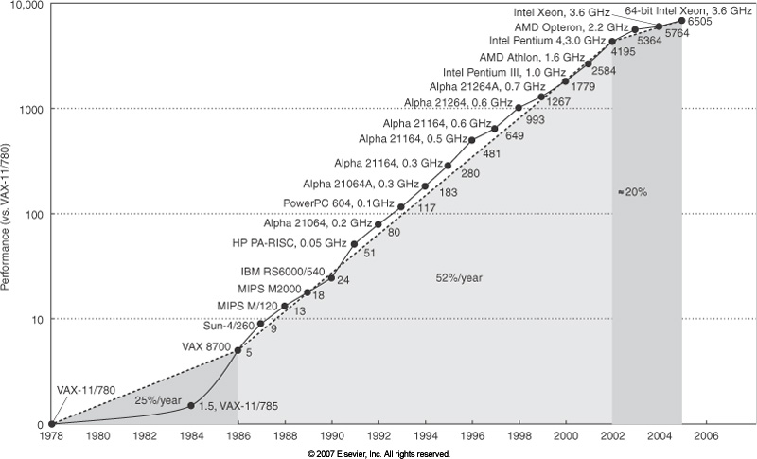
Performance Trend
Doubling the number of people on a
project doesn’t speed it up by 2x
Similarly, 2x transistors does not
automatically get you 2x performance
Possible because of continued
advances in computer architecture.
Much of computer architecture is
about how do you organize these
resources to get more done

Slide 16
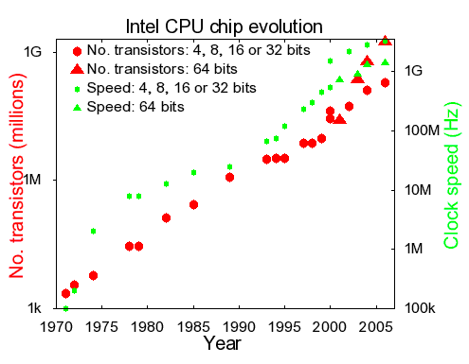
How We Increased Single-Core Performance?
Packing more transistors on a single chip
Enabled by Moore’s Law
Representative: superscalar
Increasing clock frequency
Enabled by device scaling
Representative: pipeline

Slide 17
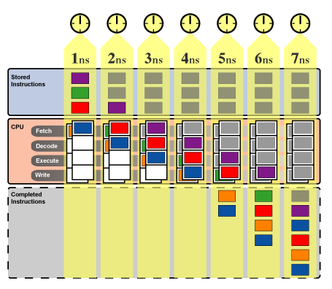
1980: Superscalar
Deploy multiple functional units
10 CPI → 5 CPI
Implicit instruction level parallelism
2-way to 8-way instruction issue
Out-of-order execution
Branch prediction
Reached a limit when 1000s instructions on the fly

Slide 18
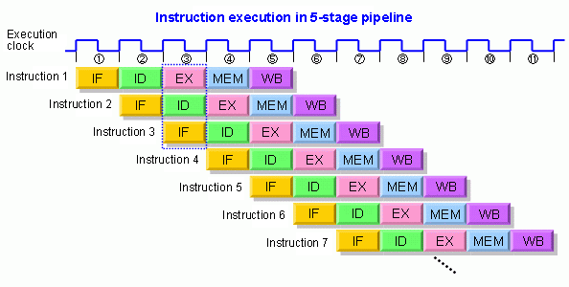
1990: Pipeline
5 CPI → 0.5 CPI
Implicit instruction level parallelism in time domain
Allows faster clock frequency

Slide 19
2001:Hyper-Threading technology
allows each microprocessor core to execute two software threads at the same time.
a processor with Hyper-Threading Technology consists of two logical processors per core, each of which has its own processor architectural state.
Each logical processor can be individually halted, interrupted or directed to execute a specified thread, independently from the other logical processor sharing the same physical core.
the logical processors in a hyper-threaded core share the execution resources.

Slide 20
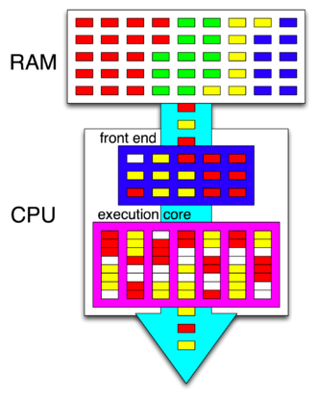
Instructions are fetched from RAM (differently colored boxes represent the instructions of four different programs), decoded and reordered by the front end (white boxes represent pipeline bubbles), and passed to the execution core capable of executing instructions from two different programs during the same clock cycle

Slide 21
HTT-Benefits
The main function of hyper-threading is to increase the number of independent instructions in the pipeline; it takes advantage of superscalar architecture, in which multiple instructions operate on separate data in parallel.
With HTT, one physical core appears as two processors to the operating system, which can use each core to schedule two processes at once.
Two or more processes can use the same resources: if resources for one process are not available, then another process can continue if its resources are available.

Slide 22
HTT-Drawbacks
Requiring simultaneous multithreading (SMT) support in the operating system
Hyper-threading can be properly utilized only with an operating system specifically optimized for it(e.g. Windows 2000 and Linux older than 2.4)
Intel recommends HTT to be disabled when using operating systems unaware of this hardware feature.
Energy inefficiency

Slide 23
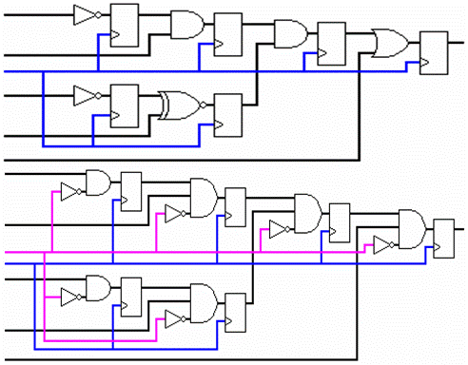
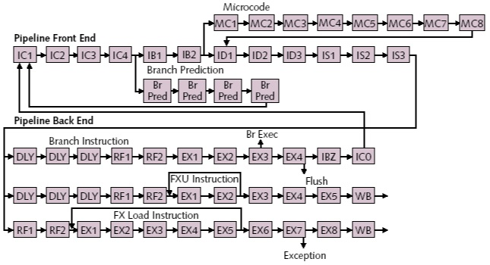
Faster Clock : Diminishing Return
The increasing clock frequency
30% from scaling
70% from shortening of pipeline stage
Approaching limits (6-7 gates/stage)
逻辑深度

Slide 24
“Power Wall”
P=CV²f
1 GHz CPU: ~25 W
3 GHz CPU: ~100 W
Failure of Prescott

Slide 25
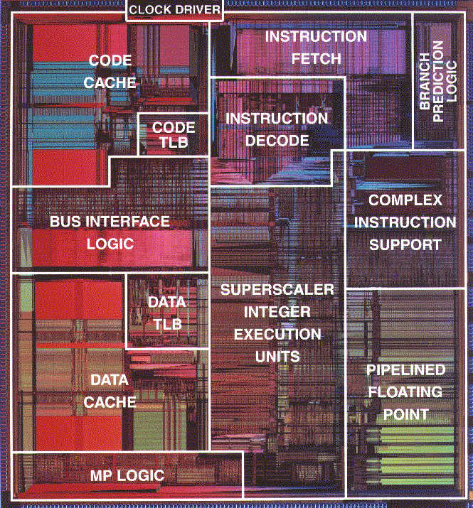
“Memory Wall”
It’s extremely hard to reduce memory latency
Logic
60%/yr (2X/1.5 yrs)
DRAM
9%/yr (2X/10 yrs)

Slide 26
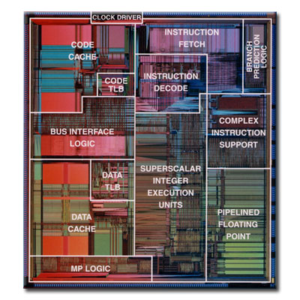
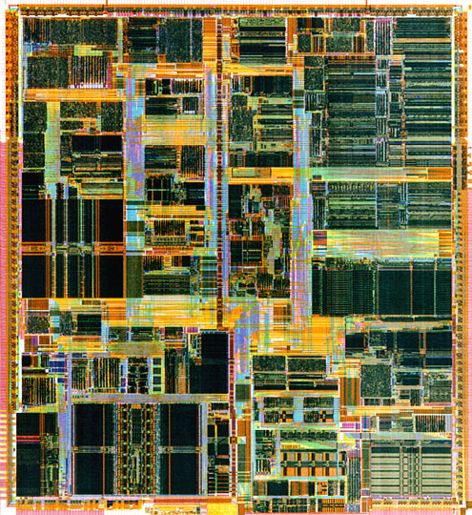
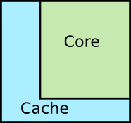

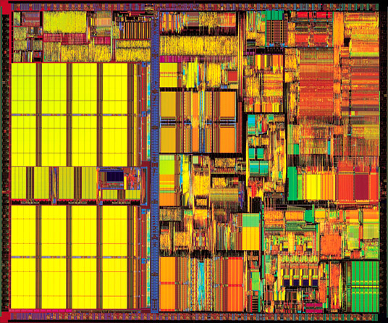
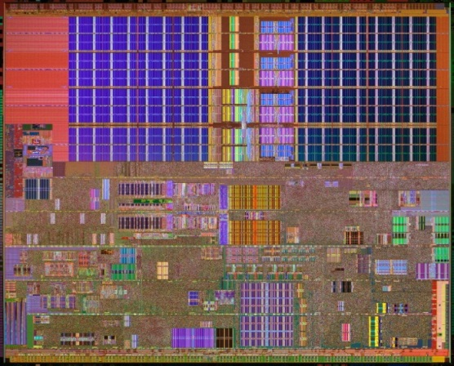


Evolution of Pentium
Pentium I
Pentium II
Chip area
breakdown
Pentium III
Pentium IV

Slide 27
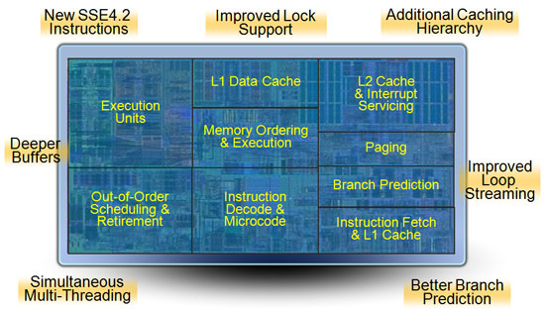
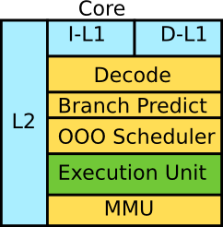
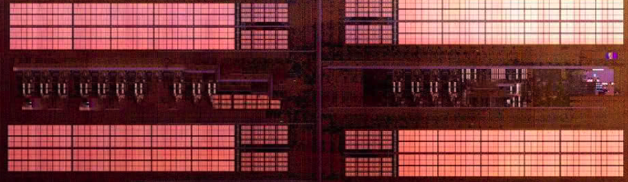
A Closer Look
Typically <10% of total chip area is used for real execution
L2 cache

Slide 28
A little physics lesson
Smaller transistors = faster processors.
Faster processors = increased power consumption.
Increased power consumption = increased heat.
Increased heat = unreliable processors.

Slide 29
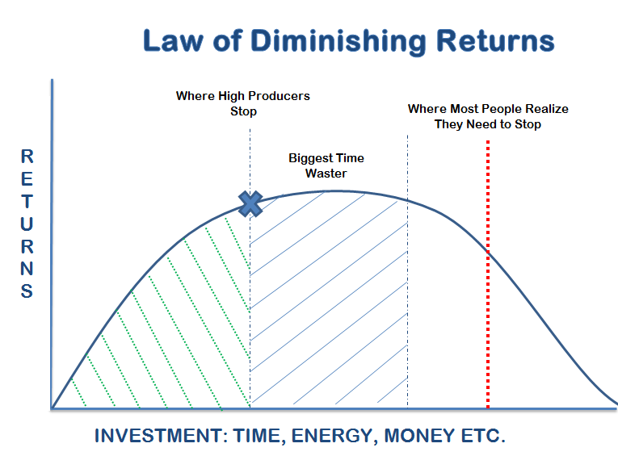
Summary
Single-core performance is becoming saturated
Traditional means to enhance the performance of single-core have diminishing returns
Power Wall prevent further enhance the performance of single-core
Memory Wall cause a lot of processor chip area is occupied by cache

Slide 30
An intelligent solution
Instead of designing and building faster microprocessors, put multiple processors on a single integrated circuit.

Slide 31
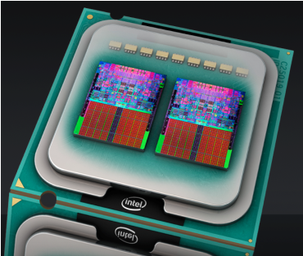
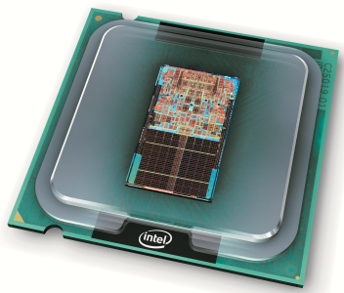
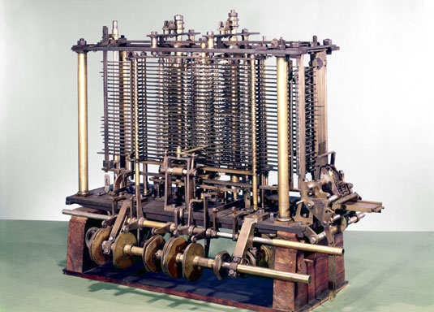
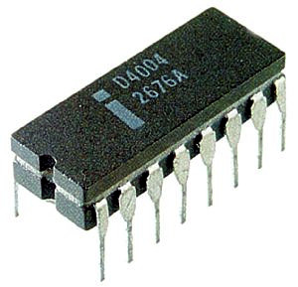
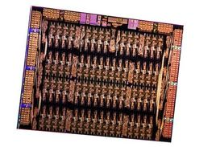
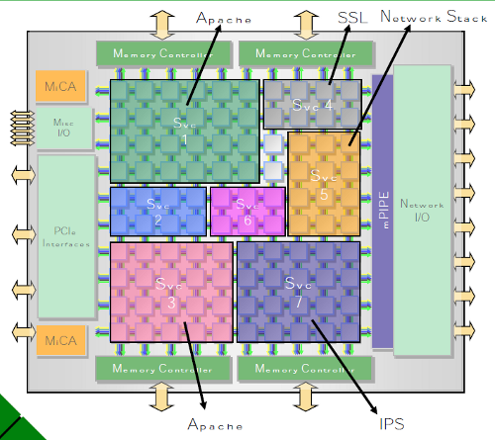
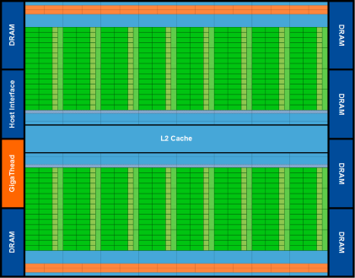
The Evolution to Parallel Processors
Single Core (1971)
Multi/Many Core (2006)
Analytical Engine (1871)
Intel
Xeon Phi(MIC,KNL)
Tilera Tile64
NVIDIA G80

Slide 32
Now it’s up to the programmers
Adding more processors doesn’t help much if programmers aren’t aware of them…
… or don’t know how to use them.
Serial programs don’t benefit from this approach (in most cases).

Slide 33


Shift to Parallel Computing

Slide 34
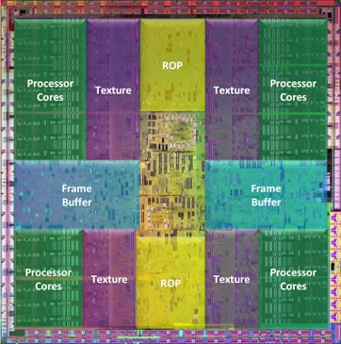
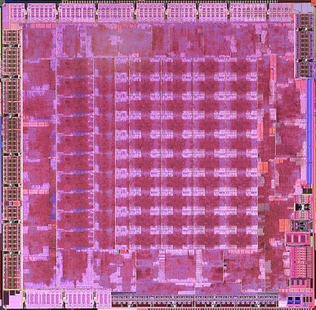
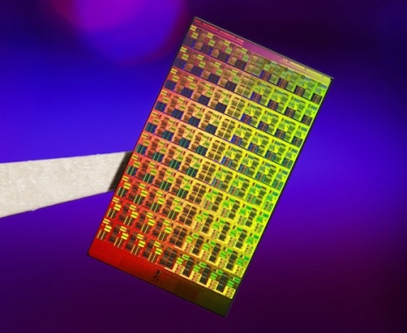
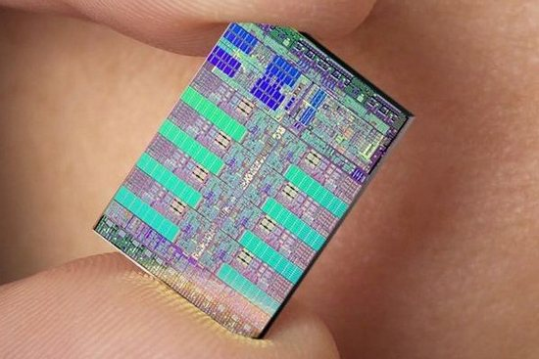
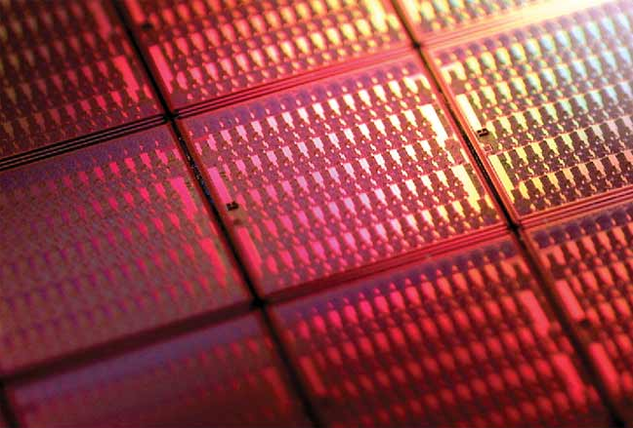
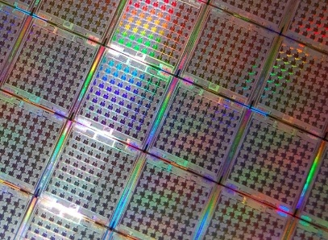
Challenge of Parallel Programming
Parallel processors are there, but how do we unleash their computer power?
NVIDIA Fermi
AMD RV870
Intel MIC
IBM Cell
PicoChip PC102
Tilera Tile 64

Slide 35

Why we need to write parallel programs
Running multiple instances of a serial program often isn’t very useful.
Think of running multiple instances of your favorite game.
What you really want is for it to run faster.

Slide 36
Approaches to the serial problem
Rewrite serial programs so that they’re parallel.
Write translation programs that automatically convert serial programs into parallel programs.
This is very difficult to do.
Success has been limited.

Slide 37
More problems
Some coding constructs can be recognized by an automatic program generator, and converted to a parallel construct.
However, it’s likely that the result will be a very inefficient program.
Sometimes the best parallel solution is to step back and devise an entirely new algorithm.

Slide 38
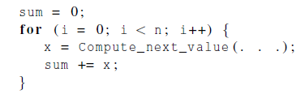
Example
Compute n values and add them together.
Serial solution:

Slide 39
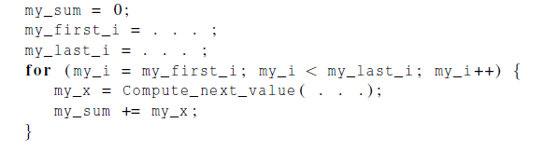
Example (cont.)
We have p cores, p much smaller than n.
Each core performs a partial sum of approximately n/p values.
Each core uses it’s own private variables
and executes this block of code independently of the other cores.

Slide 40
Example (cont.)
After each core completes execution of the code, is a private variable my_sum contains the sum of the values computed by its calls to Compute_next_value.
Ex., 8 cores, n = 24, then the calls to Compute_next_value return:
1,4,3, 9,2,8, 5,1,1, 5,2,7, 2,5,0, 4,1,8, 6,5,1, 2,3,9

Slide 41
Example (cont.)
Once all the cores are done computing their private my_sum, they form a global sum by sending results to a designated “master” core which adds the final result.

Slide 42
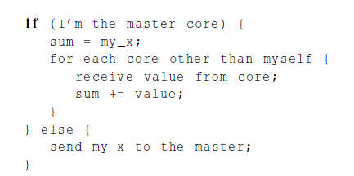
Example (cont.)

Slide 43
Example (cont.)
Core | 0 | 1 | 2 | 3 | 4 | 5 | 6 | 7
my_sum | 8 | 19 | 7 | 15 | 7 | 13 | 12 | 14
Global sum
8 + 19 + 7 + 15 + 7 + 13 + 12 + 14 = 95
Core | 0 | 1 | 2 | 3 | 4 | 5 | 6 | 7
my_sum | 95 | 19 | 7 | 15 | 7 | 13 | 12 | 14

Slide 44

But wait!
There’s a much better way to compute the global sum.

Slide 45
Better parallel algorithm
Don’t make the master core do all the work.
Share it among the other cores.
Pair the cores so that core 0 adds its result with core 1’s result.
Core 2 adds its result with core 3’s result, etc.
Work with odd and even numbered pairs of cores.

Slide 46
Better parallel algorithm (cont.)
Repeat the process now with only the evenly ranked cores.
Core 0 adds result from core 2.
Core 4 adds the result from core 6, etc.
Now cores divisible by 4 repeat the process, and so forth, until core 0 has the final result.

Slide 47
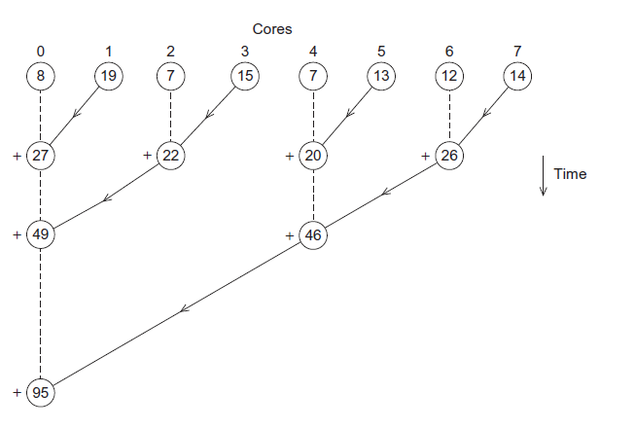
Multiple cores forming a global sum

Slide 48
Analysis
In the first example, the master core performs 7 receives and 7 additions.
In the second example, the master core performs 3 receives and 3 additions.
The improvement is more than a factor of 2!

Slide 49
Analysis (cont.)
The difference is more dramatic with a larger number of cores.
If we have 1000 cores:
The first example would require the master to perform 999 receives and 999 additions.
The second example would only require 10 receives and 10 additions.
That’s an improvement of almost a factor of 100!

Slide 50
How do we write parallel programs?
Task parallelism
Partition various tasks carried out solving the problem among the cores.
Data parallelism
Partition the data used in solving the problem among the cores.
Each core carries out similar operations on it’s part of the data.

Slide 51

Professor P
15 questions
300 exams

Slide 52

Professor P’s grading assistants
TA#1
TA#2
TA#3

Slide 53
Division of work – data parallelism
TA#1
TA#3
100 exams
100 exams
TA#2
100 exams

Slide 54
Division of work – task parallelism
TA#1
TA#3
Questions 11 - 15
Questions 1 - 5
TA#2
Questions 6 - 10

Slide 55
Division of work – data parallelism

Slide 56
Division of work – task parallelism
Tasks
Receiving
Addition

Slide 57
Coordination
Cores usually need to coordinate their work.
Communication – one or more cores send their current partial sums to another core.
Load balancing – share the work evenly among the cores so that one is not heavily loaded.
Synchronization – because each core works at its own pace, make sure cores do not get too far ahead of the rest.

Slide 58
What we’ll be doing
Learning to write programs that are explicitly parallel.
Using the C language.
Using three different extensions to C.
Message-Passing Interface (MPI)
Posix Threads (Pthreads)
OpenMP

Slide 59
Type of parallel systems
Shared-memory
The cores can share access to the computer’s memory.
Coordinate the cores by having them examine and update shared memory locations.
Distributed-memory
Each core has its own, private memory.
The cores must communicate explicitly by sending messages across a network.

Slide 60
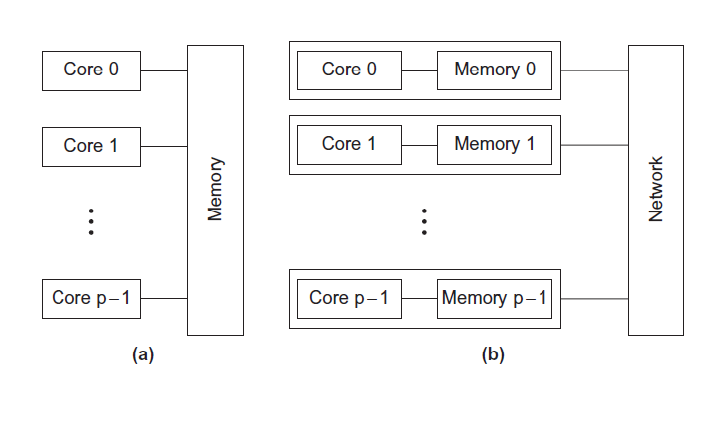
Type of parallel systems
Shared-memory
Distributed-memory

Slide 61
Terminology
Concurrent computing – a program is one in which multiple tasks can be in progress at any instant.
Parallel computing – a program is one in which multiple tasks cooperate closely to solve a problem
Distributed computing – a program may need to cooperate with other programs to solve a problem.

Slide 62

Performance Evaluation

Slide 63

Speedup
Number of computing units= p
Serial run-time = T_{serial}
Parallel run-time = T_{parallel}
linear speedup
T_{parallel} = T_{serial} / p

Slide 64
Speedup of a parallel program
T_{serial}
S =
T_{parallel}

Slide 65
Efficiency of a parallel program
T_{serial}
T_{parallel}
S
T_{serial}
E =
=
=
.
p
p
p T_{parallel}

Slide 66
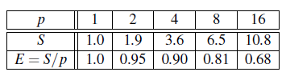
Speedups and efficiencies of a parallel program

Slide 67
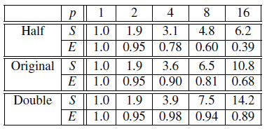
Speedups and efficiencies of parallel program on different problem sizes

Slide 68
Speedup

Slide 69
Efficiency

Slide 70
Effect of overhead
T_{parallel} = T_{serial} / p + T_{overhead}

Slide 71

Amdahl’s Law
Unless virtually all of a serial program is parallelized, the possible speedup is going to be very limited — regardless of the number of cores available.

Slide 72
Example
We can parallelize 90% of a serial program.
Parallelization is “perfect” regardless of the number of cores p we use.
T_{serial} = 20 seconds
Runtime of parallelizable part is
0.9 x T_{serial} / p = 18 / p

Slide 73
Example (cont.)
Runtime of “unparallelizable” part is
Overall parallel run-time is
0.1 x T_{serial} = 2
T_{parallel} = 0.9 x T_{serial} / p + 0.1 x T_{serial} = 18 / p + 2

Slide 74
Example (cont.)
Speed up
T_{serial}
20
S =
=
0.9 x T_{serial} / p + 0.1 x T_{serial}
18 / p + 2

Slide 75
Scalability
In general, a problem is scalable if it can handle ever increasing problem sizes.
If we increase the number of processes/threads and keep the efficiency fixed without increasing problem size, the problem is strongly scalable.
If we keep the efficiency fixed by increasing the problem size at the same rate as we increase the number of processes/threads, the problem is weakly scalable.

Slide 76

Taking Timings
What is time?
Start to finish?
A program segment of interest?
CPU time?
Wall clock time?

Slide 77
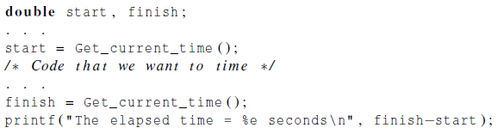
Taking Timings
theoretical
function
omp_get_wtime
MPI_Wtime

Slide 78
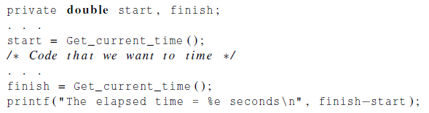
Taking Timings

Slide 79
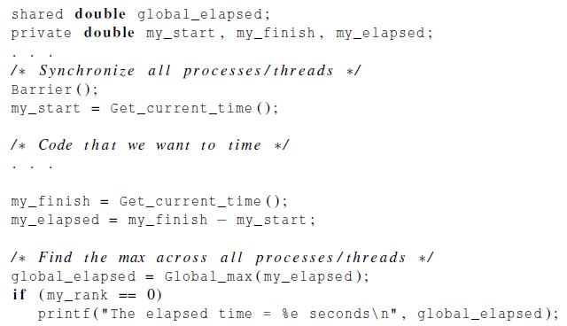
Taking Timings

Slide 80
Concluding Remarks (1)
The laws of physics have brought us to the doorstep of multicore technology.
Serial programs typically don’t benefit from multiple cores.
Automatic parallel program generation from serial program code isn’t the most efficient approach to get high performance from multicore computers.

Slide 81
Concluding Remarks (2)
Learning to write parallel programs involves learning how to coordinate the cores.
Parallel programs are usually very complex and therefore, require sound program techniques and development.

Slide 82
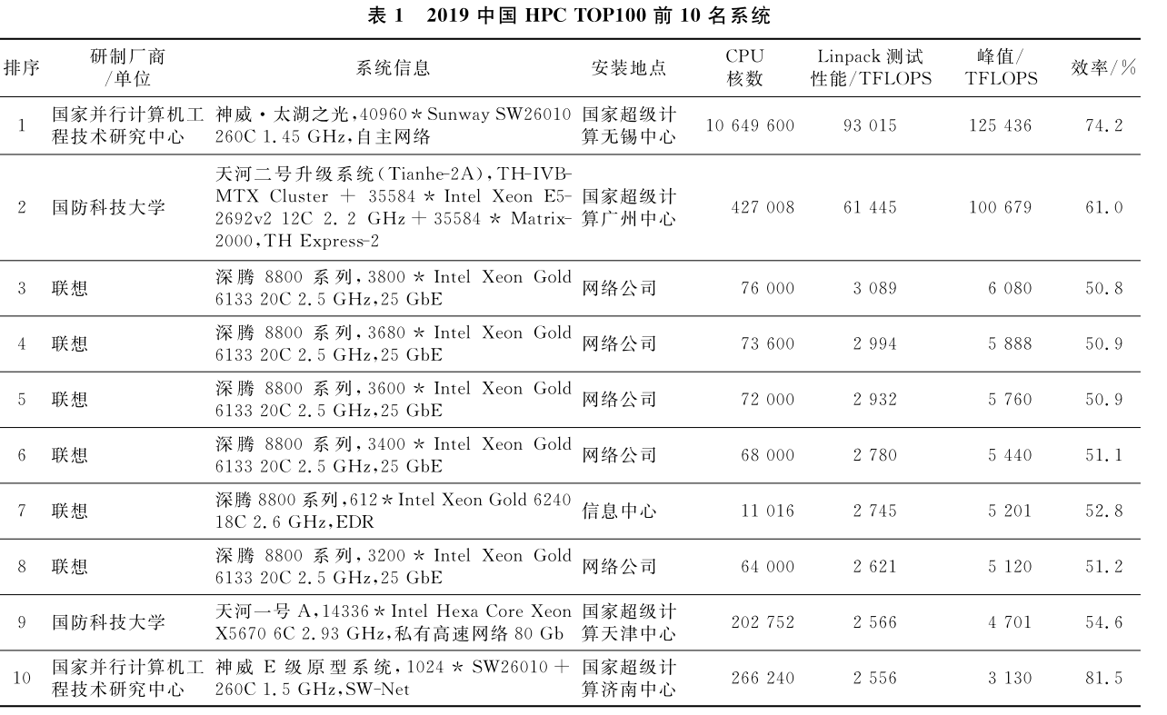
袁国兴； 张云泉； 袁良. 2019年中国高性能计算机发展现状分析

Slide 83
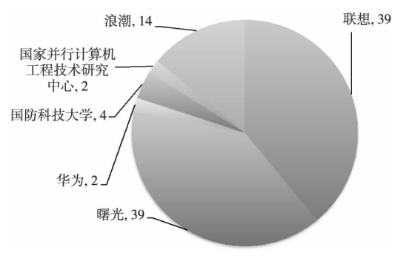
制造商（前100套）

Slide 84
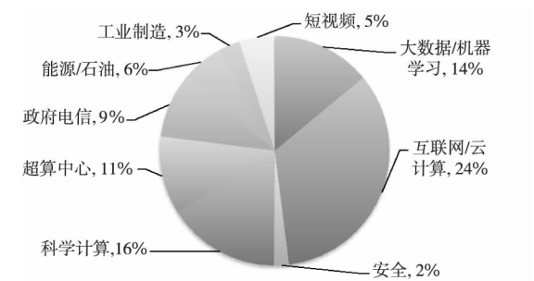
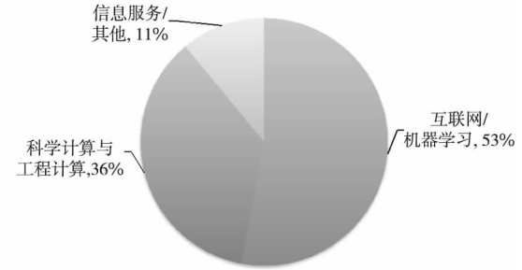
应用领域

Slide 85
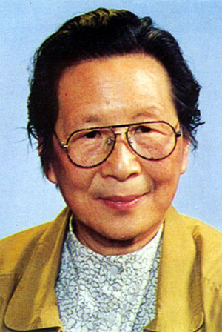
夏培肃
夏培肃（1923.7.28—2014.8.27），女，四川省江津市人。计算机专家，中国计算机事业的奠基人之一， “中国计算机之母”。
1960年，试制成功中国第一台通用电子计算机——107计算机
20世纪70年代末期，夏培肃主持研制高速阵列处理机150-AP，每秒1400万次
20世纪80年代到20世纪90年代，负责GF-10功能分布式阵列处理机系列和BJ 并行计算机系列的研制

Slide 86
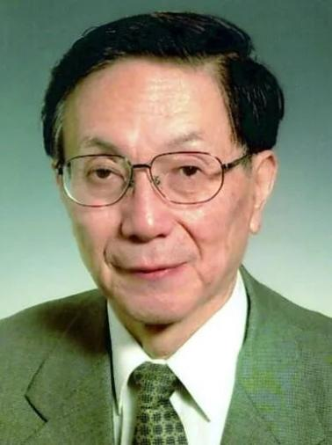
金怡濂
金怡濂（1929.9.5-），天津人 [1] ，中国高性能计算机领域著名专家，中国巨型计算机事业开拓者，“神威”超级计算机总设计师, 2003年第三届“国家最高科学技术奖”唯一获奖者
1958年参加中国第一台大型电子计算机-104机；
主持研制了国内首台双处理器结构的大型计算机；参与组织领导了我国首台标量亿次巨型机的研制，主持从工程上实现了多处理并行的体系结构；领导开展我国第一台10亿次巨型机的研制；
2001年，金怡濂领导设计的“神威II”巨型计算机运行速度达到13.1万亿次。

Slide 87

慈云桂
慈云桂（1917.4.5—1990.7.21），安徽桐城人，电子计算机专家、中国科学院院士, “中国巨型计算机之父” 。
研制成功中国第一台专用数字计算机样机、中国第一台晶体管通用数字计算机441B—I型、441B－Ⅱ型、441B－Ⅲ型大中型晶体管通用数字计算机.
200万次的大型集成电路通用数字计算机151—3/4型
中国第一台亿次级巨型计算机

